Slide 1
What is random forest
Random Forest is a popular machine learning algorithm that belongs to the supervised learning technique.
It can be used for both Classification and Regression problems in ML. .
Ensemble learning techniques is used to improve the accuracy, and performance of machine learning models.
It is based on the concept of ensemble learning, which is a process of combining multiple classifiers to solve a complex problem and to improve the performance of the model.
"Random Forest is a classifier that contains a number of decision trees on various subsets of the given dataset and takes the average to improve the predictive accuracy of that dataset."

Slide 2
What is random forest(Contd..)
Random Forest is a classifier that contains several decision trees on various subsets of a given dataset and takes the average to enhance the predicted accuracy of that dataset.
Random forests work well for a large range of data items than a single decision tree does.
Random forest has less variance than a single decision tree.
Random forests are very flexible and possess very high accuracy.
Scaling of data does not require in the random forest algorithm. It maintains good accuracy even after providing data without scaling.
Random Forest algorithms maintain good accuracy even a large proportion of the data is missing.

Slide 3
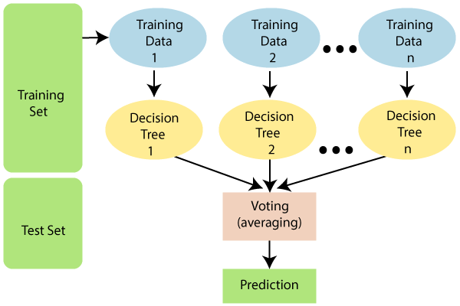
random forest

Slide 4
Example:
Suppose there is a dataset that contains multiple fruit images.
So, this dataset is given to the Random forest classifier.
The dataset is divided into subsets and given to each decision tree.
During the training phase, each decision tree produces a prediction result, and when a new data point occurs, then based on the majority of results, the Random Forest classifier predicts the final decision.

Slide 5
How does Random Forest algorithm work?
The Working process can be explained in the below steps and diagram:
Step-1: Select random K data points from the training set.
Step-2: Build the decision trees associated with the selected data points (Subsets).
Step-3: Choose the number N for decision trees that you want to build.
Step-4: Repeat Step 1 & 2.

Slide 6
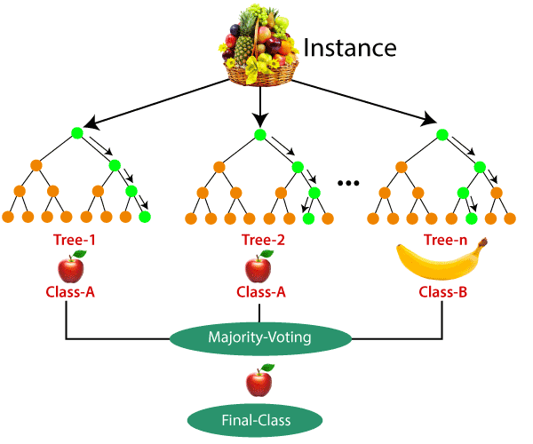
random forest:

Slide 7
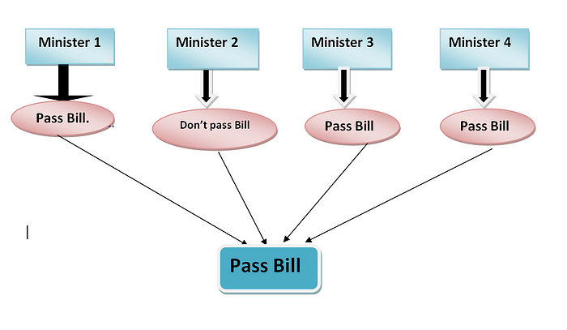
So now, let’s compare it with a real-life example.

Slide 8
Applications of Random Forest
There are mainly four sectors where Random forest mostly used:
Banking: Banking sector mostly uses this algorithm for the identification of loan risk.
Medicine: With the help of this algorithm, disease trends and risks of the disease can be identified.
Land Use: We can identify the areas of similar land use by this algorithm.
Marketing: Marketing trends can be identified using this algorithm.

Slide 9
Conclusion
Random Forest is a popular machine learning algorithm that belongs to the supervised learning technique.
"Random Forest is a classifier that contains a number of decision trees on various subsets of the given dataset and takes the average to improve the predictive accuracy of that dataset."
Random forest is a Supervised Machine Learning Algorithm that is used widely in Classification and Regression problems.
Bagging, also known as bootstrap aggregation and Random Forest is the ensemble learning method that is commonly used to improve the performance within a noisy dataset.
It builds decision trees on different samples and takes their majority vote for classification

